Slide 1
Book Recommender model UBCF
Build a UBCF from book-crossing dataset
Salma Elshahahwy
DATA612, Summer 2020
Notebook: https://www.kaggle.com/salmaeng/book-recommender-system
GitHub: https://github.com/salma71/book_recommendation_model/blob/master/Book_recommender_system.ipynb

Slide 2
Content
Model overview
Dataset description
Cleaning and Munging
Model computation
Results and conclusion

Slide 3
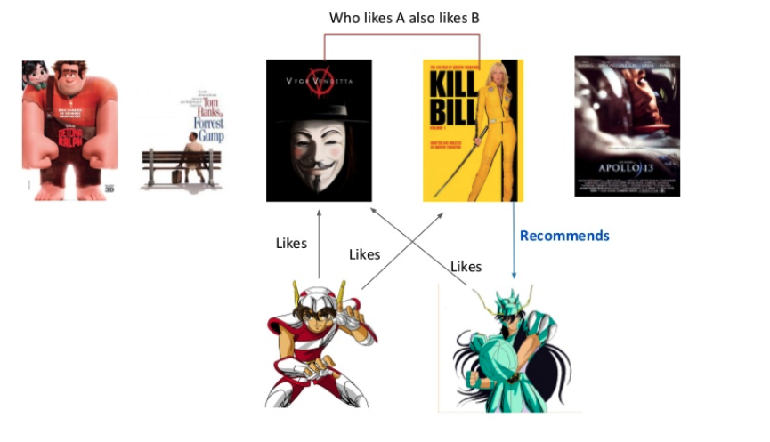
Model Overview
Ref: Discovering User's Topics of Interest in Recommender Systems

Slide 4
Dataset overview
This dataset has been compiled by Cai-Nicolas Ziegler in 2004, and it consistis of three tables for users, books and ratings. Explicit ratings are expressed on a scale from 1-10 (higher values denoting higher appreciation) and implicit ratings are expressed by 0
Link to dataset files http://www2.informatik.uni-freiburg.de/~cziegler/BX/

Slide 5
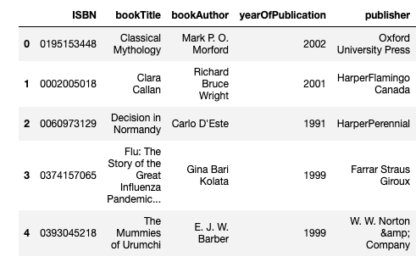
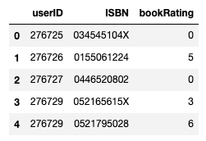
Dataset Description
Books
Ratings

Slide 6
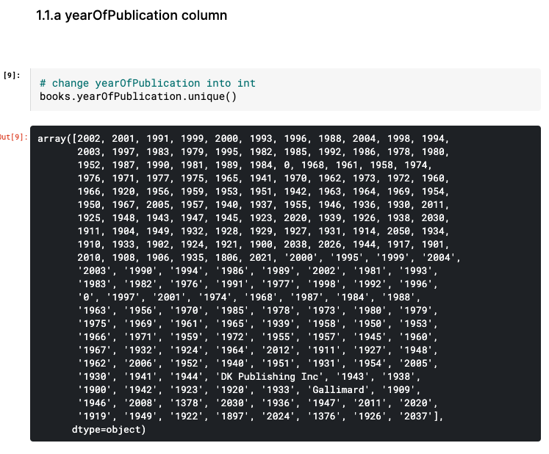
Cleaning and Munging
Drop unnecessary columns
Correct mislabeled data
Change types
Check missing values
Data sparsity

Slide 7
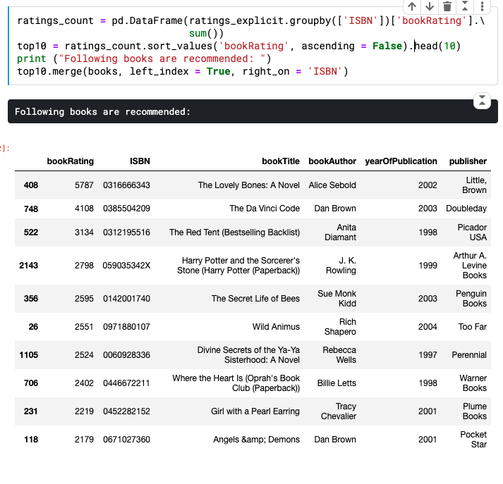
Model Computation - popular model

Slide 8
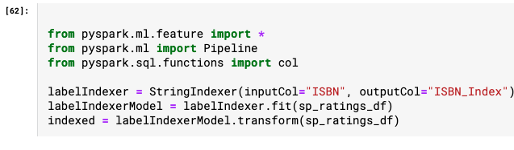
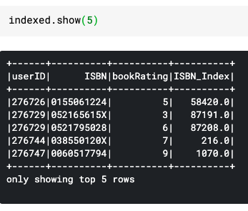
Model Computation - UBCF
Converting ISBN string into index

Slide 9
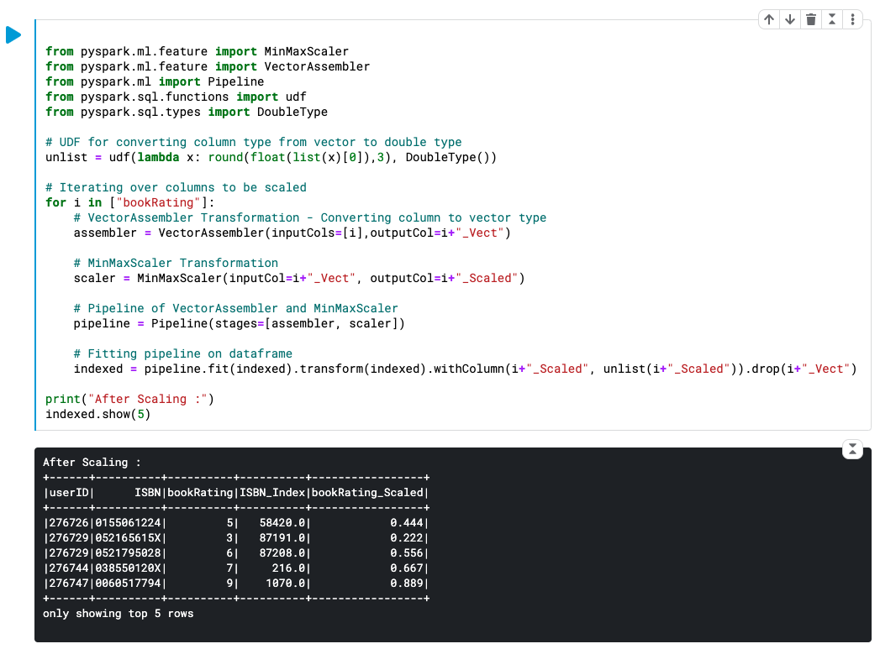
Model Computation - UBCF
2. Normalize rating column

Slide 10
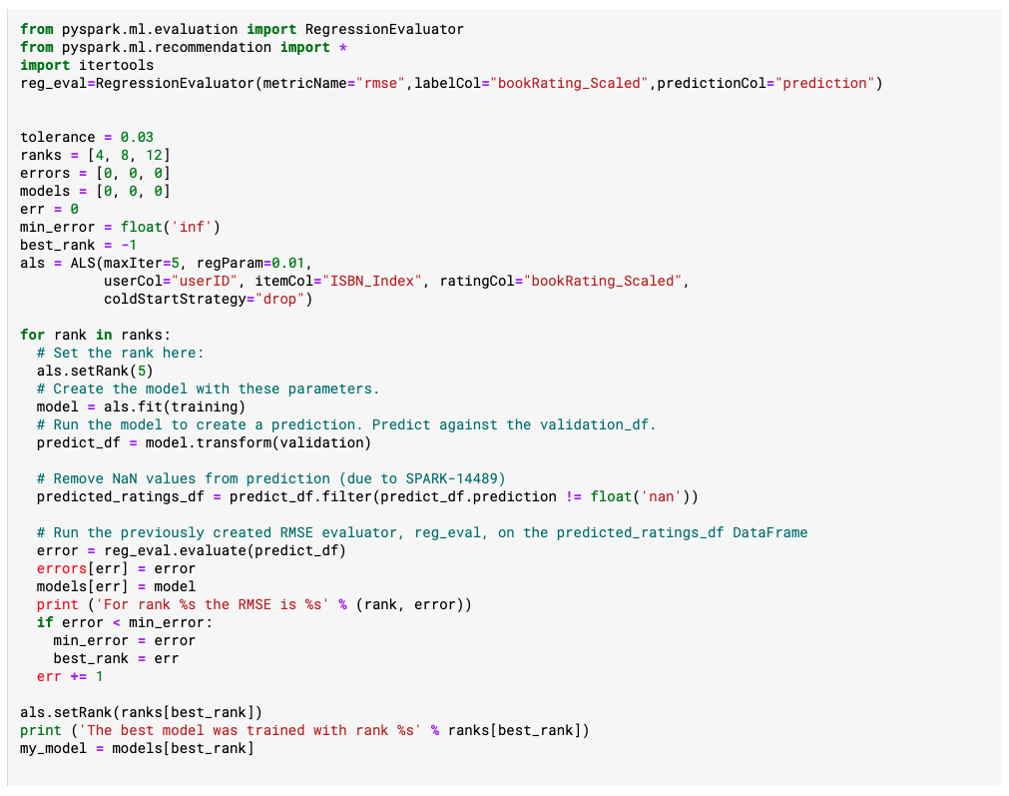
Model Computation - UBCF
Build my own cross validation

Slide 11
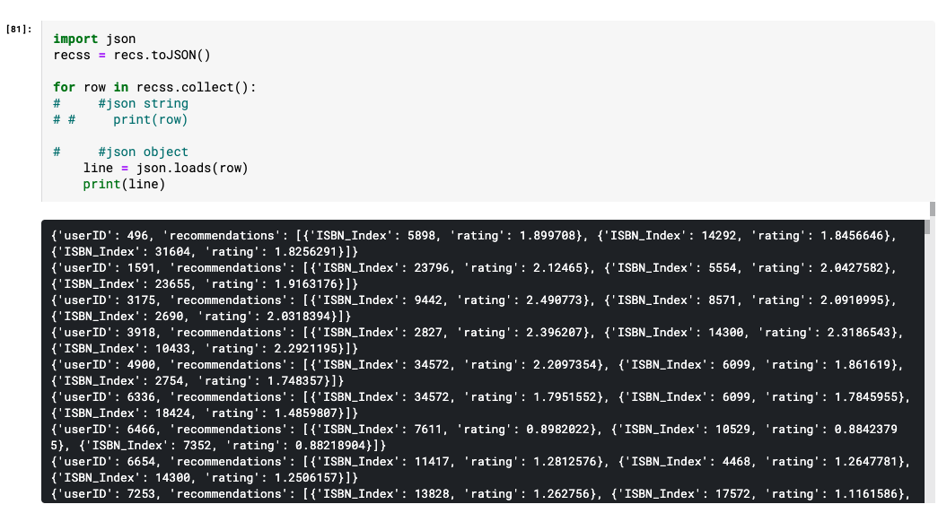
Model Computation - UBCF
Results in a JSON format

Slide 12
Conclusion &
Future work
1. I used only the accuracy based metric RMSE; however, many other metric could be used like @MAP, @recall...etc.
2. We can convert back the ISBN_Index into the original ISBN string in the recommendation object, then we can join with the books table and get book recomendation by book title.
3. We can use the users, books, and rating tables to build a recommender model using RNN - next step for me.
4. A content-based recommendation model could be built using bookTitle and do even more by expanding it and hypertune it.

